Slide 1
Lecture 8
Chapter-02
Discrete-Event System Simulation
-Jerry Banks
Other Examples of Simulation

Slide 2
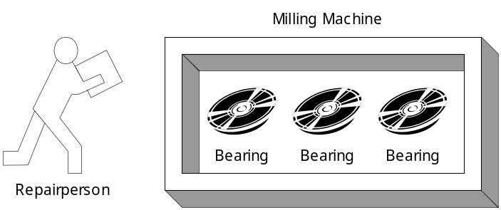
Other Examples of Simulation (1)
Example 2.5 A Reliability Problem
  Downtime for the mill is estimated at $5 per minute.
  The direct on-site cost of the repairperson is $15 per hour.
  It takes 20 minutes to change one bearing, 30 minutes to change two bearings, and 40 minutes to change three bearings.
  The bearings cost $16 each.
  A proposal has been made to replace all three bearings whenever a bearing fails.

Slide 3
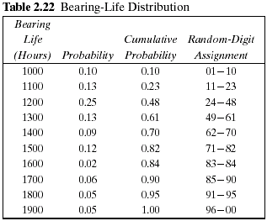
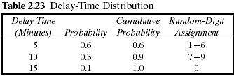
Other Examples of Simulation (2)
Example 2.5 (Cont.)
  The delay time of the repairperson's arriving at the milling machine is also a random variable, with the distribution given in Table 2.23.
  The cumulative distribution function of the life of each bearing is identical, as shown in Table 2.22.

Slide 4
Other Examples of Simulation (2)
Random Digit for wheels life:
Random Digit for Delay Time:
RD for life of Bearing-1 | 67,8,49,84,44,30,10,63,2,2,77,59,23,53,85,75
RD for life of Bearing-2 | 70,43,86,93,81,44,19,51,45,12,48,9,44,46,40,52
RD for life of Bearing-3 | 76,65,61,96,65,56,11,86,57,49,36,44,94,78
RD for delay of Proposal | 63,21,85,53,23,5,29,51
RD for delay of Bearing-1 | 2,3,1,7,8,1,2,8,3,8,7,5,5,9,6,4
RD for delay of Bearing-2 | 0,7,3,1,2,8,1,1,7,8,0,8,1,2,8,5
RD for delay of Bearing-3 | 0,2,7,1,3,3,6,3,6,3,1,4,8,2,1,7
RD for delay of Proposal | 3,7,5,1,4,3,7,8,8,3,2,4,1,6,2,7,0,5

Slide 5
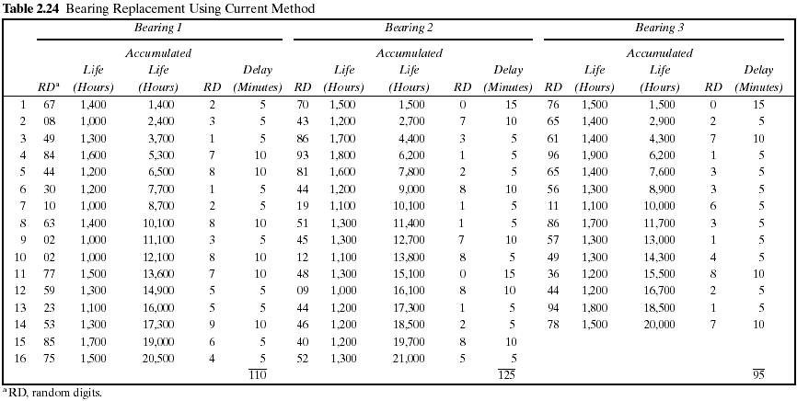

Slide 6
Other Examples of Simulation (3)
Example 2.5 (Cont.)
  Table 2.24 represents a simulation of 20,000 hours of operation under the current method of operation.
  Note that there are instances where more than one bearing fails at the same time.
  This is unlikely to occur in practice and is due to using a rather coarse grid of 100 hours.
  It will be assumed in this example that the times are never exactly the same, and thus no more than one bearing is changed at any breakdown. Sixteen bearing changes were made for bearings 1 and 2, but only 14 bearing changes were required for bearing 3.

Slide 7
Other Examples of Simulation (4)
Example 2.5 (Cont.)
  The cost of the current system is estimated as follows:
    Cost of bearings = 46 bearings × $16/bearing = $736
    Cost of delay time = (110 + 125 + 95) minutes × $5/minute = $1650
    Cost of downtime during repair =
    46 bearings × 20 minutes/bearing × $5/minute = $4600
    Cost of repairpersons =
    (46 bearings × 20 minutes/bearing)/60 × $15 minutes = $230
    Total cost = $736 + $1650 + $4600 + $230 = $7216
  Table 2.25 is a simulation using the proposed method. Notice that bearing life is taken from Table 2.24, so that for as many bearings as were used in the current method, the bearing life is identical for both methods.

Slide 8
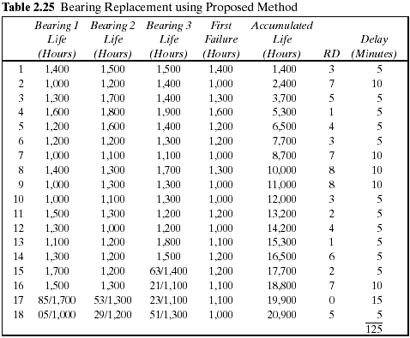

Slide 9
Other Examples of Simulation (5)
Example 2.5 (Cont.)
  Since the proposed method uses more bearings than the current method, the second simulation uses new random digits for generating the additional lifetimes.
  The random digits that lead to the lives of the additional bearings are shown above the slashed line beginning with the 15th replacement of bearing 3.
  The total cost of the new policy :
    Cost of bearings = 54 bearings × $16/bearing = $864
    Cost of delay time = 125 minutes × $5/minute = $625
    Cost of downtime during repairs = 18 sets × 40 minutes/set × $5/minute = $3600
    Cost of repairpersons = 18 sets × 40 minutes/set × $15/60 minutes = $180
    Total cost = $864 + $625 + $3600 + $180 = $5269
  The new policy generates a savings of $1947 over a 20,000-hour simulation. If the machine runs continuously, the simulated time is about 2 1/4 years. Thus, the savings are about $865 per year.

